Slide 1
Data Recovery System

Slide 2
OUTLINE
System Failure
Classification of Failure
Storage Types
Redundant Arrays of Independent Disks (RAID)
Improvement of Reliability via Redundancy
Improvement in Performance via Parallelism
RAID Levels
Log-Based Recovery
Deferred Database modification technique
Immediate Database Modification Technique

Slide 3
Data Recovery System
System Failure
A computer system, like any other device, is subject to failure from a variety of causes:
Disk crash
Power outage
Software error
A fire in the machine room
Sabotage.
In any failure, information may be lost. Therefore, the database system must take actions in advance to ensure that the atomicity and durability properties of transactions are preserved.

Slide 4
Data Recovery System
Classification of Failure
There are various types of failure that may occur in a system:
Transaction Failure
System Crash
Disk Failure.

Slide 5
Data Recovery System
Classification of Failure
Transaction Failure. There are two types of errors that may cause a transaction to fail:
Logical error. The transaction can no longer continue with its normal execution because of some internal condition, such as bad input, data not found, overflow, or resource limit exceeded.
System error. The system has entered an undesirable state (for example, deadlock) as a result of which a transaction cannot continue with its normal execution. The transaction, however, can be re-executed at a later time.

Slide 6
Data Recovery System
Classification of Failure
System Crash. There is a hardware malfunction, or a bug in the database software or the operating system, that causes the loss of the content of volatile storage, and brings transaction processing to a halt. The content of nonvolatile storage remains intact, and is not corrupted.
Disk Failure. A disk block loses its content as a result of either a head crash or failure during a data transfer operation. Copies of the data on other disks, or archival backups on tertiary media, such as tapes, are used to recover from the failure.

Slide 7
Data Recovery System
Storage Types
Volatile storage. Data in volatile storage, such as in RAM, are lost when the computer crashes.
Nonvolatile storage. Data in nonvolatile storage, such as disk, are not lost when the computer crashes, but may occasionally be lost because of failures such as disk crashes (for example, head crash).
Stable storage. Data in stable storage are never lost. Although stable storage is theoretically impossible to obtain, it can be closely approximated by techniques that make data loss extremely unlikely.

Slide 8
Data Recovery System
Stable-Storage Implementation
To implement stable storage, we need to replicate the needed information in several nonvolatile storage media (usually disk) with independent failure modes, and to update the information in a controlled manner to ensure that failure during data transfer does not damage the needed information.
RAID systems guarantee that the failure of a single disk (even during data transfer) will not result in loss of data. The simplest and fastest form of RAID is the mirrored disk, which keeps two copies of each block, on separate disks. Other forms of RAID offer lower costs, but at the expense of lower performance.

Slide 9
Data Recovery System
Stable-Storage Implementation
RAID systems, however, cannot guard against data loss due to disasters such as fires or flooding. More secure systems keep a copy of each block of stable storage at a remote site, writing it out over a computer network, in addition to storing the block on a local disk system. Since the blocks are output to a remote system as and when they are output to local storage, once an output operation is complete, the output is not lost, even in the event of a disaster such as a fire or flood.

Slide 10
Data Recovery System
What is RAID?
RAID stands for Redundant Arrays of Independent Disks.
The term was defined by David Patterson, Garth A. Gibson, and Randy Katz at the University of California in 1987.
It is a technology that makes use of a combination of multiple disks for storing the data instead of using a single disk for increased performance, data redundancy, or to protect data in the case of a drive failure depending on the RAID level used.
If one drive stops working, your data is still safe because you have other copies stored on the other drives.
The main purpose of RAID is to improve data reliability, availability, and performance.
Different RAID levels are used to achieve different goals.

Slide 11
Data Recovery System
Advantages of RAID Technology
Data redundancy: By keeping numerous copies of the data on many disks, RAID can shield data from disk failures.
Performance enhancement: RAID can enhance performance by distributing data over several drives, enabling the simultaneous execution of several read / write operations.
Scalability: RAID is scalable, therefore by adding more disks to the array, the storage capacity may be expanded.
Versatility: RAID is applicable to a wide range of devices, such as workstations, servers, and personal PCs
Fault Tolerance: RAID configurations with redundancy can continue to operate even if one or more disks fail, minimizing downtime and data loss.

Slide 12
Data Recovery System
Drawbacks of RAID Technology / Downsides of using RAID
Cost: RAID implementation can be costly, particularly for arrays with large capacities.
Complexity: The setup and management of RAID might be challenging.
Decreased performance: The parity calculations necessary for some RAID configurations may result in a decrease in speed.
Single point of failure: The array’s whole contents could be lost if the RAID controller malfunctions.
Nested RAID levels are more expensive to implement than traditional RAID levels because they require many disks.
RAID arrays are in a vulnerable state until a failed drive is replaced and the new disk is populated with data.

Slide 13
Data Recovery System
When should you use RAID Technology?
Instances where it is useful to have a RAID setup include:
When a large amount of data needs to be restored. If a drive fails and data is lost, that data can be restored quickly, because this data is also stored in other drives.
When uptime and availability are important business factors. If data needs to be restored, it can be done quickly without downtime.
When working with large files. RAID provides speed and reliability when working with large files.
When an organization needs to reduce strain on physical hardware and increase overall performance. As an example, a hardware RAID card can include additional memory to be used as a cache.
When having I/O disk issues. RAID will provide additional throughput by reading and writing data from multiple drives, instead of needing to wait for one drive to perform tasks.
When cost is a factor. The cost of a RAID array is lower than it was in the past, and lower-priced disks are used in large numbers, making it cheaper.

Slide 14
Data Recovery System
What is a RAID Controller?
It is like a manager for your hard drives in a big storage system.
It works between your computer’s operating system and the actual hard drives, organizing them into groups to make them easier to manage.
This helps speed up how fast your computer can read and write data, and it also adds a layer of protection in case one of your hard drives breaks down.
Types of RAID controller
Basically two types of RAID controller.
Hardware Based RAID controller and
Software Based RAID controller

Slide 15
Data Recovery System
Hardware Based RAID Controller
In hardware-based RAID, there’s a physical controller that manages the whole array.
This controller can handle the whole group of hard drives together. It’s designed to work with different types of hard drives, like SATA (Serial Advanced Technology Attachment) or SCSI (Small Computer System Interface).
Sometimes, this controller is built right into the computer’s main board, making it easier to set up and manage your RAID system.

Slide 16
Data Recovery System
Software Based RAID Controller
In software-based RAID, the controller doesn’t have its own special hardware.
So, it uses computer’s main processor and memory to do its job.
But because it’s sharing resources with other programs on your computer, it might not make things run as fast. So, while it’s still helpful, it might not give you as big of a speed boost as a hardware-based RAID system

Slide 17
Data Recovery System
Improvement of Reliability via Redundancy of Disks
Reliability can be improved via redundancy of disks.
The simplest approach is to duplicate every disk. This technique is called mirroring or shadowing.
A logical disk consists of two physical disks, and every write is carried out on both disks. If one of the disks fails, the data can be read from the other.
Data will be lost only if the second disk fails before the first failed disk is repaired.

Slide 18
Data Recovery System
Improvement in Performance via Parallelism
With multiple disks, we can improve the transfer rate by striping data across multiple disks.
Two types of Data Striping: Bit-level Striping and Block-level Striping
Bit-level Striping
Simplest form Data Striping.
It consists of splitting the bits of each byte across multiple disks.
For example, if we have an array of eight disks, we write bit i of each byte to disk i. The array of eight disks can be treated as a single disk with sectors that are eight times the normal size, and, more important, that has eight times the transfer rate.

Slide 19
Data Recovery System
Block-level Striping
It stripes blocks across multiple disks. It treats the array of disks as a single large disk, and it gives blocks logical numbers; we assume the block numbers start from 0. With an array of n disks, block-level striping assigns logical block i of the disk array to disk (i mod n) + 1; it uses the th physical block of the disk to store logical block i. For example, with 8 disks, logical block 0 is stored in physical block 0 of disk 1, while logical block 11 is stored in physical block 1 of disk 4.
When reading a large file, block-level striping fetches n blocks at a time in parallel from the n disks, giving a high data transfer rate for large reads.
Block level striping is the most commonly used form of data striping.

Slide 20
Data Recovery System
RAID Technology
There are 7 levels of RAID schemes.
RAID-0 (Non-redundant Stripping)
RAID-1 (Mirroring)
RAID-2 (Bit-Level Stripping with Dedicated Parity)
RAID-3 (Byte-Level Stripping with Dedicated Parity)
RAID-4 (Block-Level Stripping with Dedicated Parity)
RAID-5 (Block-Level Stripping with Distributed Parity)
RAID-6 (Block-Level Stripping with two Parity Bits)

Slide 21
Data Recovery System
Characteristics of RAID Technology
It contains a set of physical disk drives.
In this technology, the operating system views these separate disks as a single logical disk.
In this technology, data is distributed across the physical drives of the array.
Redundancy disk capacity is used to store parity information.
In case of disk failure, the parity information can be used to recover the data.

Slide 22
Data Recovery System
RAID-0 (How does RAID-0 Work?)
RAID-0 is also known as disk stripping.
Disk Stripping is the technique of breaking data into multiple blocks and storing those blocks on several storage disks.
A minimum of 2 disks are used in RAID-0.
It does not provide data redundancy.
It provides improved performance and additional storage but no fault tolerance. Any drive failure destroys the array, and the likelihood of failure increases with more drives in the array.
Suppose we have data named D and we break it into multiple blocks of data namely D1, D2, D3, D4, D5, and D6, and store them into two different disks. Below is a diagram depicting this.

Slide 23
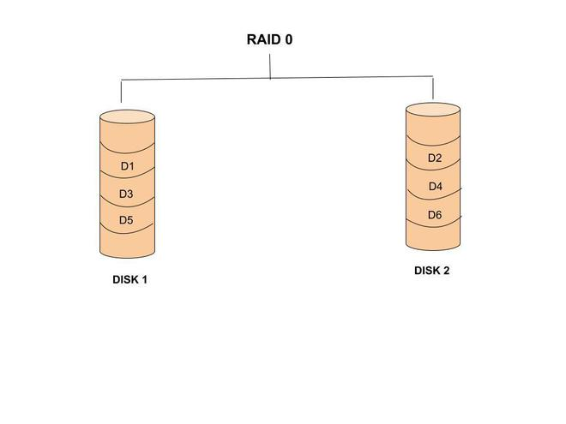
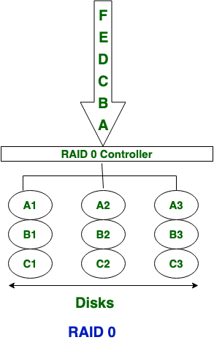
Data Recovery System
RAID-0 (How does RAID-0 Work?)

Slide 24
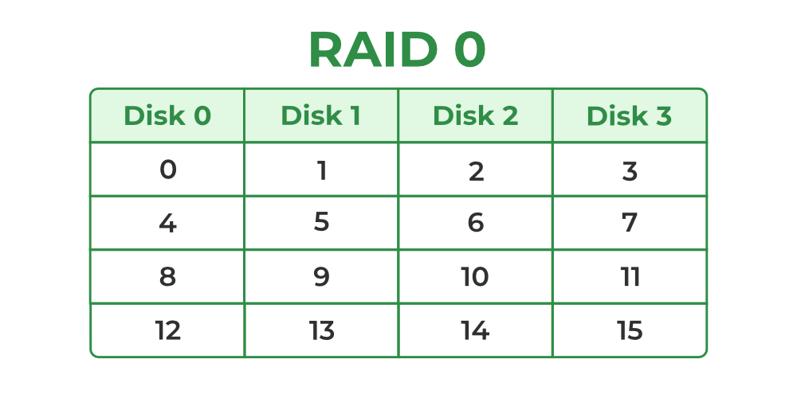
Data Recovery System
RAID-0 (How does RAID-0 Work?)
Another example for 4 disks.
In the figure, blocks “0, 1, 2, 3” form a stripe.
There is no duplication of data. Hence, a block once lost cannot be recovered.

Slide 25
Data Recovery System
Advantages of RAID-0
RAID-0 provides high performance. The disks are independent and therefore we can read and write data in different disks in parallel.
The cost incurred in RAID-0 is low.
The entire capacity of the disk is used for storing data in RAID-0, since there is no duplication of data.
The technology is simple and easy to implement.

Slide 26
Data Recovery System
Disadvantages of RAID-0
It does not provide any fault tolerance as there is no duplication of data. Hence, a block once lost cannot be recovered.
A single drive loss can result in the complete failure of the system.
It’s not a good choice for a critical system.
Therefore, RAID-0 can be mostly used only in cases where maximum performance is required by the applications.
RAID-0 is frequently used for video editing and live broadcasting because of its speed and performance.

Slide 27
Data Recovery System
RAID-1 (How does RAID-1 Work?)
This level is called mirroring of data as it copies the data from drive 1 to drive 2 (mirroring level 2).
It provides 100% redundancy. If one of the drives fails, the data is still available in the other drives.
Example:

Slide 28
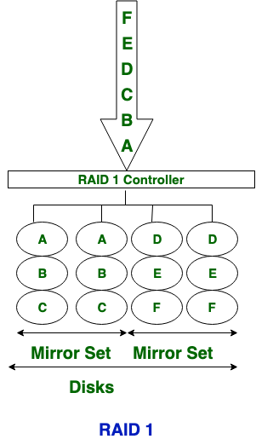
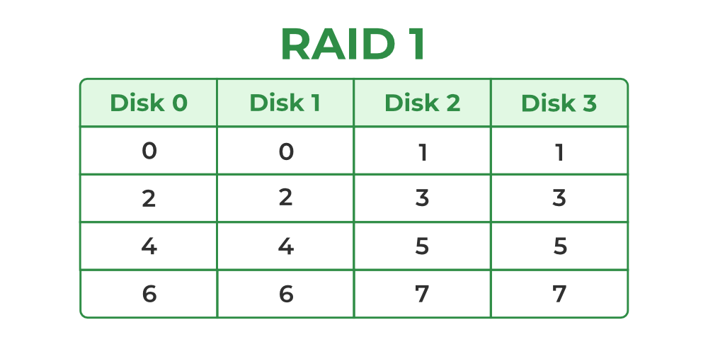
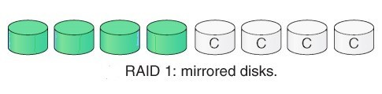
Data Recovery System
RAID-1 (How does RAID-1 Work?)
Only half space of the drive is used to store the data. The other half of drive is just a mirror to the already stored data.

Slide 29
Data Recovery System
Advantages of RAID-1
The main advantage is fault tolerance. If one disk fails, then the other automatically takes over.
Provides Full data backups.
It’s easy to recover data from the mirrored drive.
In this level, the array will function even if any one of the drives fails.
Less complicated to configure and administer as compared to other RAID levels.

Slide 30
Data Recovery System
Disadvantages of RAID-1
It is highly expensive.
Storage capacity is less. Because in this level, one extra drive is required per drive for mirroring.
It requires at least two drives.
Examples
A server that has duplicated drives in order to ensure availability of the data in case that the drives fail.
A home office computer with two SSDs in a mirrored configuration for documents.
An application that requires high availability and maximum data consistency.
A data backup system that provides near-real-time duplicates of the essential data in at least two drives.
Difference between RAID-0 and RAID-1
In RAID-0 technology, Disk stripping is used. While in RAID-1 technology, Disk mirroring is used.
The cost of RAID-0 technology is low. While RAID-1 is costly or expensive.
In RAID-0, there is no write penalty. While in RAID-1, there is write penalty.
The relative storage efficiency of RAID-0 is 100%. While the relative storage efficiency of RAID-1 is 50%.
The write performance of RAID-0 is better than RAID-1.
RAID-0 emphasis on data accessing speed. While in RAID-1, data availability is emphasized.
RAID-0 is well in read performance. While RAID-1 is moderate in read performance.
In RAID-0, there is no protection available. In RAID-1, mirror protection is provided.
RAID-0 involves the splitting of data into small blocks and spreading it across multiple disks in a way that allows for simultaneous read and write operations. In this configuration, each disk contains a portion of the data, and data is written to and read from the disks in parallel. RAID-0 does not provide fault tolerance, as there is no redundancy or backup copy of the data. If one disk fails, all data on the array is lost.
RAID-1 involves the duplication of data on two or more disks. In this configuration, all data is written to two or more disks simultaneously, so that each disk contains an identical copy of the data. This provides fault tolerance, as if one disk fails, the system can continue to operate with the remaining disk(s) until the failed disk is replaced.

Slide 31
Data Recovery System
Difference between RAID-0 and RAID-1
In RAID-0 technology, Disk stripping is used. While in RAID-1 technology, Disk mirroring is used.
The cost of RAID-0 technology is low. While RAID-1 is expensive.
In RAID-0, there is no write penalty. While in RAID-1, there is write penalty.
The relative storage efficiency of RAID-0 is 100%. While the relative storage efficiency of RAID-1 is 50%.
The write performance of RAID-0 is better than RAID-1.
RAID-0 emphasis on data accessing speed. While in RAID-1, data availability is emphasized.

Slide 32
Data Recovery System
Difference between RAID-0 and RAID-1
RAID-0 is well in read performance. While RAID-1 is moderate in read performance.
In RAID-0, there is no protection available. In RAID-1, mirror protection is provided.
RAID-0 involves the splitting of data into small blocks and spreading it across multiple disks in a way that allows for simultaneous read and write operations. In this configuration, each disk contains a portion of the data, and data is written to and read from the disks in parallel. RAID-0 does not provide fault tolerance, as there is no redundancy or backup copy of the data. If one disk fails, all data on the array is lost.
RAID-1 involves the duplication of data on two or more disks. In this configuration, all data is written to two or more disks simultaneously, so that each disk contains an identical copy of the data. This provides fault tolerance, as if one disk fails, the system can continue to operate with the remaining disk(s) until the failed disk is replaced.

Slide 33
Data Recovery System
RAID-2 (How does RAID-2 Work?)
Known as Bit-level stripping with dedicated parity.
Also known as Memory-style Error-Correcting-Code.
In RAID-2, data is divided into individual bits and then striped across multiple disks, with a dedicated parity disk that stores the parity information for all the data disks. The parity information is generated using Hamming code, which allows for single-bit error correction and detection.
This provides fault tolerance, as if one disk fails, the system can continue to operate with the remaining disks.

Slide 34
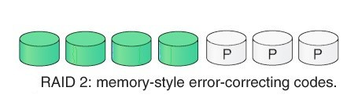
Data Recovery System
RAID-2 (How does RAID-2 Work?)
The number of redundant bits can be calculated using the following formula:
2^{r} ≥ m+r+1
where m is the number of bits in input data, and r is the number of redundant bits.
Suppose the number of input data bits is 4 (m), then the number of redundant bits (r) can be calculated using: 2^{r} ≥ 4 + r + 1. Thus, the number of redundant bits is 3.

Slide 35
Data Recovery System
Advantages of RAID-2
The error of the data is checked at every bit level
For Error Correction, it uses hamming code.
High data integration because of use of hamming code.
It uses designated drives to store parity bits.
Controller design is simpler as compared to RAID-3, RAID-4 and RAID-5.
Disadvantages of RAID-2
It has a complex structure and high cost due to extra drive.
Complex implementation requires specialized hardware. This complexity makes it expensive and difficult to set up and maintain.
The working of RAID-2 can be hard to understand.
It requires an extra drive for error detection.
Same performance can be achieved by RAID-3 at a lower cost.
It is not commercially used (outdated technology).

Slide 36
Data Recovery System
Differences between RAID-1 and RAID-2
RAID-1 | RAID-2
Disk Mirroring is used. | Bit-Level Striping is used.
One half of drive is used for storing data and another half is just a mirror for already store data | Each data bit in a word recorded on a separate disk and ECC codes are stored on different disk
Good Fault tolerance as compared to RAID-2. | Fault tolerance is not so good.
Hamming Codes are not used. | Hamming Codes are used for Error Correction.
Extra Drive is required for mirroring. | Extra Drive is required for Error Correction.

Slide 37
Data Recovery System
RAID-3 (How does RAID-3 Work?)
Known as Byte-Level Stripping with Dedicated Parity.
Data is divided into bytes and distributed across multiple disks. One special disk keeps parity information for all the data disks. If a disk fails, the data can be reconstructed using the parity information from the dedicated parity disk.
RAID-3 improves on RAID-2 by exploiting the fact that disk controllers can detect whether a disk sector has been read correctly, so a single parity bit can be used for error detection and correction.
RAID-3 is as good as RAID-2, but is less expensive in the number of extra disks (it has only a one-disk overhead), so level 2 is not used in practice.

Slide 38
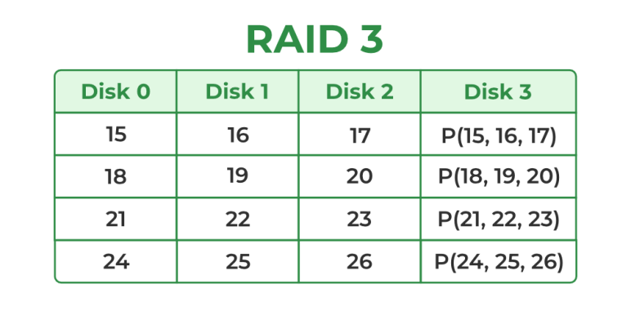
Data Recovery System
RAID-3 (How does RAID-3 Work?)
Here Disk 3 contains the Parity bits for Disk 0, Disk 1, and Disk 2. If data loss occurs, we can construct it with Disk 3.
RAID-2 and RAID-3 are not used anymore because the RAID-5 does what they do but better

Slide 39
Data Recovery System
Advantages of RAID-3
Good performance for large, sequential data transfers.
It can move large amounts of data quickly
Data can be accessed in parallel.
Simpler implementation compared to RAID-2. It uses a single parity disk, making it easier and less expensive to set up.
Efficient use of disk space with only one parity disk.
Good for video editing.
Disadvantages of RAID-3
It requires an additional drive for parity.
It gives a slow performance for operating on small sized files.
RAID-5 does the same job but work better.
RAID-3 is not used much today

Slide 40
Data Recovery System
Difference between RAID-2 and RAID-3
RAID-2 | RAID-3
Bit-level Striping is used. | Byte-level Striping is used.
One group of disk are used to write the data and other group is used to write the ECC. | Multiple disks are used for storing data and one dedicated disk is used to store parity
Hamming code is used for Error detection. | Hamming code is not used.
It requires extra drives for Error Code. | It requires extra drive for Parity.
If one of the disk fails, the remaining bits of the byte and the associated ECC bits can be used to reconstruct the data. | In case of drive failure the parity bits is accessed and data is reconstructed from the remaining drive.
Data is divided into individual bits and then striped across multiple disks, with a dedicated parity disk that stores the parity information for all the data disks. The parity information is generated using Hamming code, which allows for single-bit error correction and detection. This means that if a disk fails, the data can be reconstructed using the parity information from the dedicated parity disk. | Data is striped across multiple disks, with one dedicated parity disk that stores the parity information for all the data disks. It splits data into larger data blocks. This means that if a disk fails, the data can be reconstructed using the parity information from the dedicated parity disk.

Slide 41
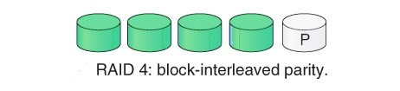
Data Recovery System
RAID-4 (How does RAID-4 Work?)
Block-Level Striping
Data is divided into blocks and distributed across multiple disks.
All of the data blocks’ parity information is kept on a single disk.
If one of the disks fails, the parity block can be used with the corresponding blocks from the other disks to restore the blocks of the failed disk.

Slide 42
Data Recovery System
Advantages of RAID-4
RAID-4 allows recovery of at most 1 disk failure.
Disadvantages of RAID-4
If more than one disk fails, there is no way to recover the data.

Slide 43
Data Recovery System
Differences between RAID-3 and RAID-4
RAID-3 | RAID-4
Byte-level Striping is used. | Block-level Striping is used.
Parity bits are generated for each disk section and stored on a different disk. | Parity bits are generated for the entire block of data and stored on a different disk
Random read will have worst performance. | Good Random reads, as the data blocks are striped.
Performance is good in case of large sized files. | Performance is low because only one block is accessed at a time

Slide 44
Data Recovery System
RAID-5 (How does RAID-5 Work?)
Known as Block-Level Stripping with Distributed Parity.
RAID-5 is a slight modification of the RAID-4 system. The only difference is that in RAID-5, the parity rotates among the drives.
It allows recovery of at most 1 disk failure. If more than one disk fails, there is no way to recover the data. This is identical to RAID-4.
In RAID-5, data is equally divided in all disks and minimum number of physical disks needed is 3.
RAID-5 is generally suited for medium level of applications.
Overall space equivalent to one disk is utilized in storing the parity. Hence, (N-1) disks are made available for data storage.

Slide 45
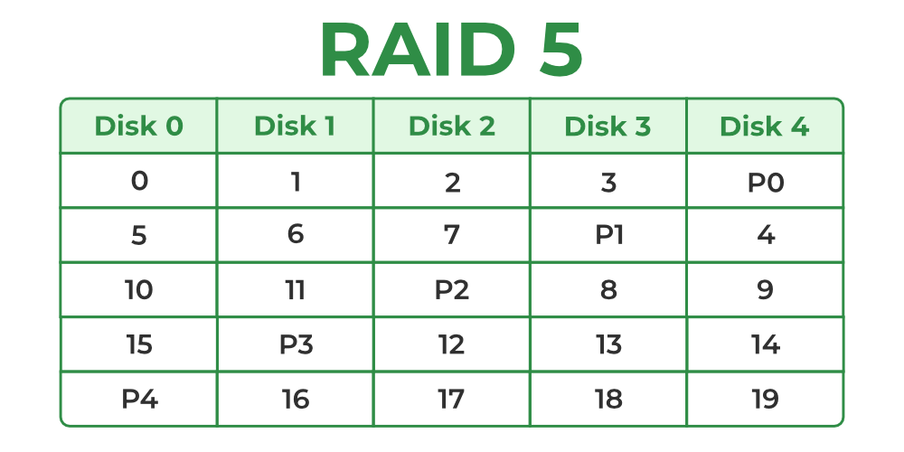
Data Recovery System
RAID-5 (How does RAID-5 Work?)
The following figure shows how the parity bit rotates.
It shows how the first 20 blocks, numbered 0 to 19, and their parity blocks are laid out.

Slide 46
Data Recovery System
Advantages of RAID-5
Data can be reconstructed using parity bits.
It makes the random write performance better.
Disadvantages of RAID-5
RAID-5 allows recovery of at most 1 disk failure. If more than one disk fails, there is no way to recover the data.
Its technology is complex and extra space is required.

Slide 47
Data Recovery System
RAID-6 (How does RAID-6 Work?)
Known as Block-Level Stripping with two Parity Bits.
P + Q redundancy scheme: uses error-correcting codes such as the Reed–Solomon codes.
RAID-6 is an extension of RAID-5. In this level two independent parities are generated and stored in distributed fashion among multiple disks.
The use of additional parity enables the array to continue functioning, even if two disks fail simultaneously.
Two parities provide additional fault tolerance.
It requires at least 4 disk drives to implement.

Slide 48
Data Recovery System
RAID-6 (How does RAID-6 Work?)
Disk 1 | Disk 2 | Disk 3 | Disk 4
A0 | B0 | Q0 | P0
A1 | Q1 | P1 | D1
Q2 | P2 | C2 | D2
P3 | B3 | C3 | Q3

Slide 49
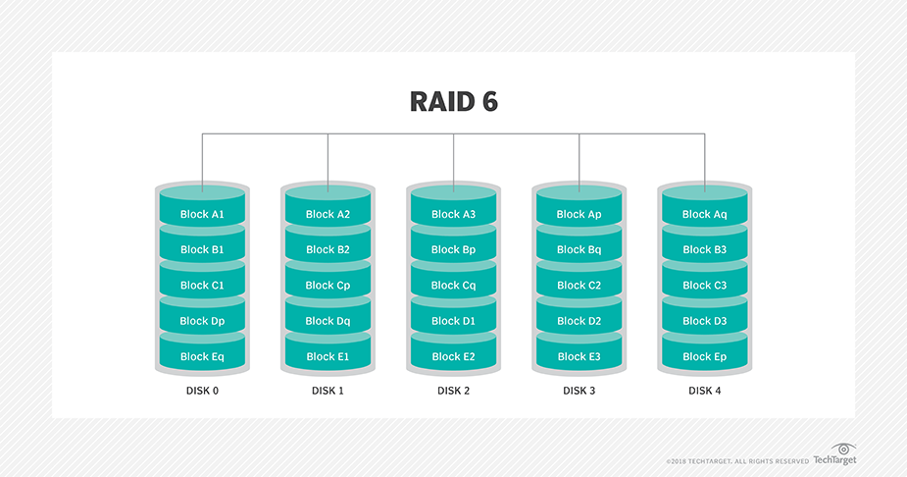
Data Recovery System
RAID-6 (How does RAID-6 Work?)

Slide 50
Data Recovery System
Advantages of RAID-6
Very high data Accessibility.
Fast read data transactions.
Disadvantages of RAID-6
Due to double parity, it has slow write data transactions.
Extra space is required.

